Slide 1
Machine Learning Basics for Plasma Physics
Aidan Crilly
Code at https://github.com/aidancrilly/ML_Lecture_Demos

Slide 2
Overview
What is Machine Learning?
Regression & Classification
Parametric Regressors
Ordinary and Non-Linear Least Squares
Bayesian Inference
Other Optimisation Problems
Non-Parametric Regressors
Gaussian Processes and Neural Networks

Slide 3
What is Machine Learning?

Slide 4
Regression & Classification

Slide 5
Regression

Slide 6
Parametric Regressors

Slide 7
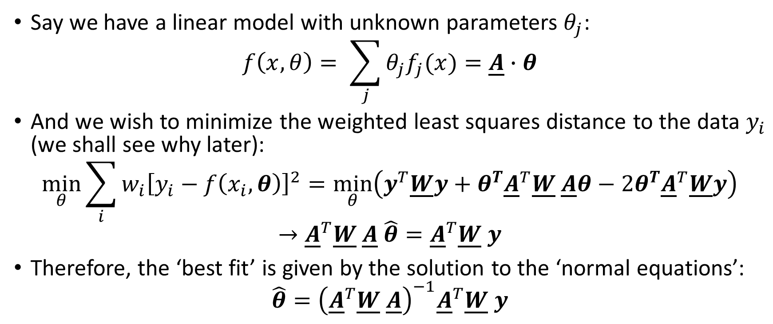
Ordinary Least Squares
Say we have a linear model with unknown parameters $θ_{j}$:
$$f\left(x,θ\right)= \sum_{j}{θ_{j}f_{j}(x)}=\underline{A}∙θ$$
And we wish to minimize the weighted least squares distance to the data $y_{i}$ (we shall see why later):
$$\min_{θ}{\sum_{i}{{w_{i}\left[y_{i}−f\left(x_{i},θ\right)\right]}^{2}}}=\min_{θ}\left(y^{T}\underline{W}y+θ^{T}{\underline{A}}^{T}\underline{W} \underline{A}θ−2θ^{T}{\underline{A}}^{T}\underline{W}y\right)$$
$$→{\underline{A}}^{T}\underline{W} \underline{A} \hat{θ}={\underline{A}}^{T}\underline{W} y$$
Therefore, the ‘best fit’ is given by the solution to the ‘normal equations’:
$$\hat{θ}={\left({\underline{A}}^{T}\underline{W} \underline{A}\right)}^{−1}{\underline{A}}^{T}\underline{W} y$$

Slide 8
Practical example 1

Slide 9
Practical example 2

Slide 10
Ill-posed/Ill-conditioned problems

Slide 11
Regularization

Slide 12
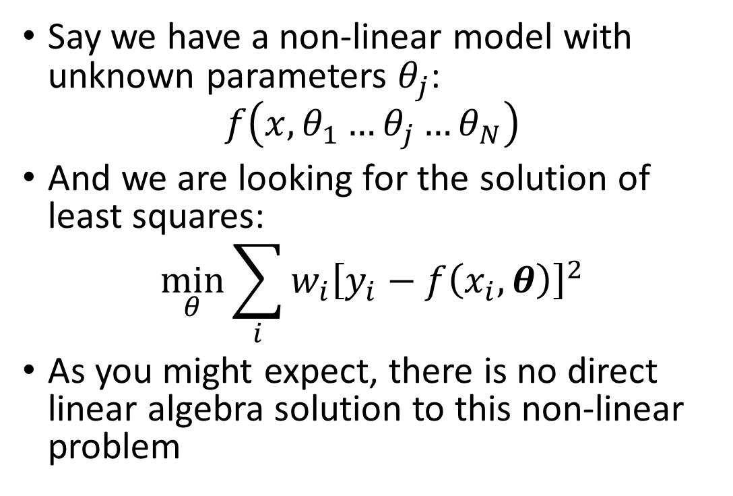
Non-Linear Least Squares
Say we have a non-linear model with unknown parameters $θ_{j}$:
$$f\left(x,θ_{1}…θ_{j}…θ_{N}\right)$$
And we are looking for the solution of least squares:
$$\min_{θ}{\sum_{i}{{w_{i}\left[y_{i}−f\left(x_{i},θ\right)\right]}^{2}}}$$
As you might expect, there is no direct linear algebra solution to this non-linear problem

Slide 13
Reminder: Newton-Raphson Method

Slide 14
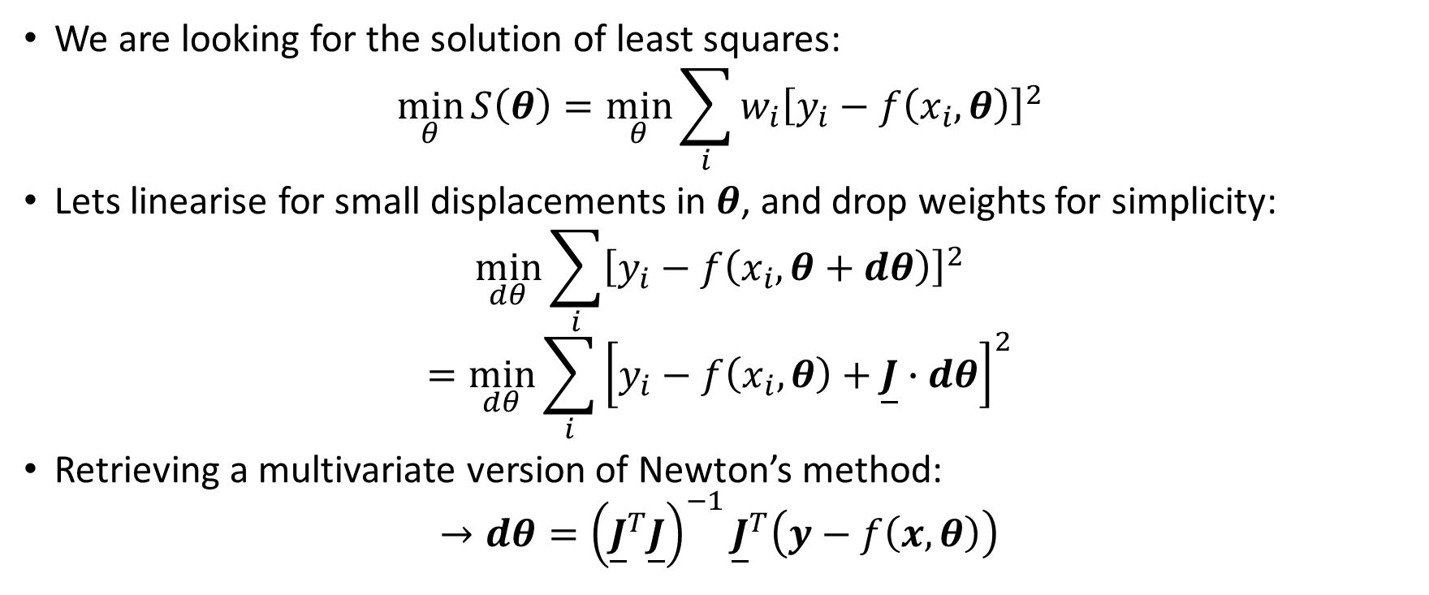
Non-Linear Least Squares
We are looking for the solution of least squares:
$$\min_{θ}{S\left(θ\right)=\min_{θ}\sum_{i}{{w_{i}\left[y_{i}−f\left(x_{i},θ\right)\right]}^{2}}}$$
Lets linearise for small displacements in $θ$, and drop weights for simplicity:
$$\min_{dθ}{\sum_{i}{{\left[y_{i}−f\left(x_{i},θ+dθ\right)\right]}^{2}}}$$
$$=\min_{dθ}{\sum_{i}{{\left[y_{i}−f\left(x_{i},θ\right)+\underline{J}∙dθ\right]}^{2}}}$$
Retrieving a multivariate version of Newton’s method:
$$→dθ={\left({\underline{J}}^{T}\underline{J}\right)}^{−1}{\underline{J}}^{T}\left(y−f\left(x,θ\right)\right)$$

Slide 15
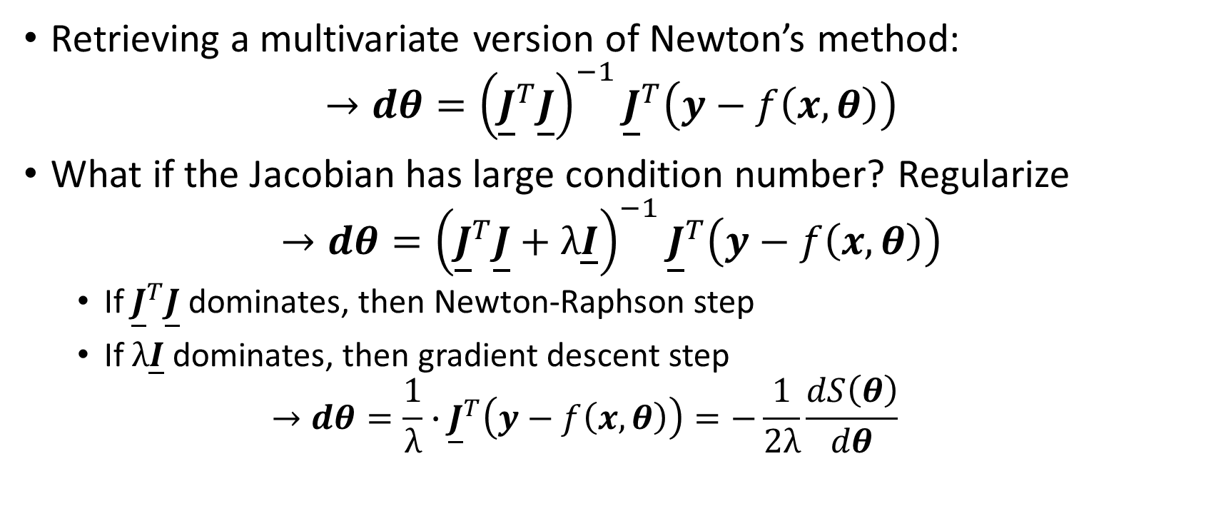
Non-Linear Least Squares
Retrieving a multivariate version of Newton’s method:
$$→dθ={\left({\underline{J}}^{T}\underline{J}\right)}^{−1}{\underline{J}}^{T}\left(y−f\left(x,θ\right)\right)$$
What if the Jacobian has large condition number? Regularize
$$→dθ={\left({\underline{J}}^{T}\underline{J}+λ\underline{I}\right)}^{−1}{\underline{J}}^{T}\left(y−f\left(x,θ\right)\right)$$
If ${\underline{J}}^{T}\underline{J}$ dominates, then Newton-Raphson step
If $λ\underline{I}$ dominates, then gradient descent step
$$→dθ=\frac{1}{λ}∙{\underline{J}}^{T}\left(y−f\left(x,θ\right)\right)=−\frac{1}{2λ}\frac{dS\left(θ\right)}{dθ}$$
N.B. Levenberg-Marquardt algorithm uses the above but adaptively changes $λ$, this is default algorithm in scipy.optimize.curve_fit

Slide 16
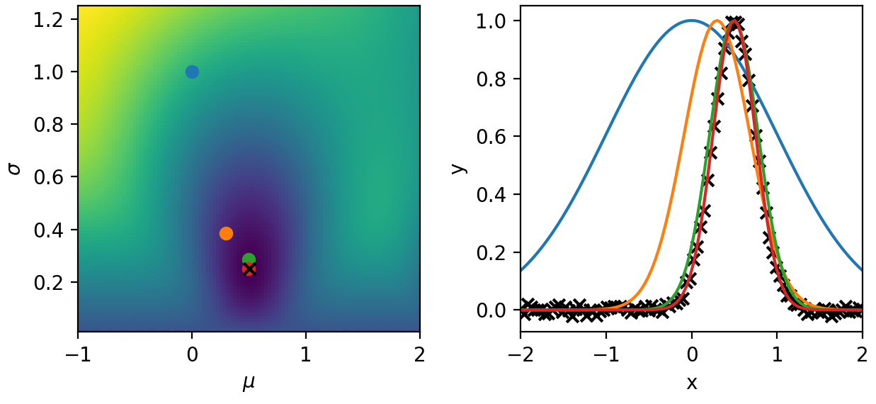


Non-Linear Least Squares
$$→dθ={\left({\underline{J}}^{T}\underline{J}+λ\underline{I}\right)}^{−1}{\underline{J}}^{T}\left(y−f\left(x,θ\right)\right)$$
If ${\underline{J}}^{T}\underline{J}$ dominates, then Newton-Raphson step
If $λ\underline{I}$ dominates, then gradient descent step
$$→dθ=\frac{1}{λ}∙{\underline{J}}^{T}\left(y−f\left(x,θ\right)\right)=−\frac{1}{2λ}\frac{dS\left(θ\right)}{dθ}$$
Newton-Raphson
Gradient Descent

Slide 17
Bayes Theorem and Likelihoods

Slide 18
Bayesian Inference

Slide 19
Bayesian Inference: Markov Chain Monte Carlo (MCMC)

Slide 20
Bayesian Inference: Markov Chain Monte Carlo (MCMC)

Slide 21
Other Optimisation Problems

Slide 22
Non-Parametric Regressors

Slide 23
Gaussian Processes

Slide 24
Gaussian Processes

Slide 25
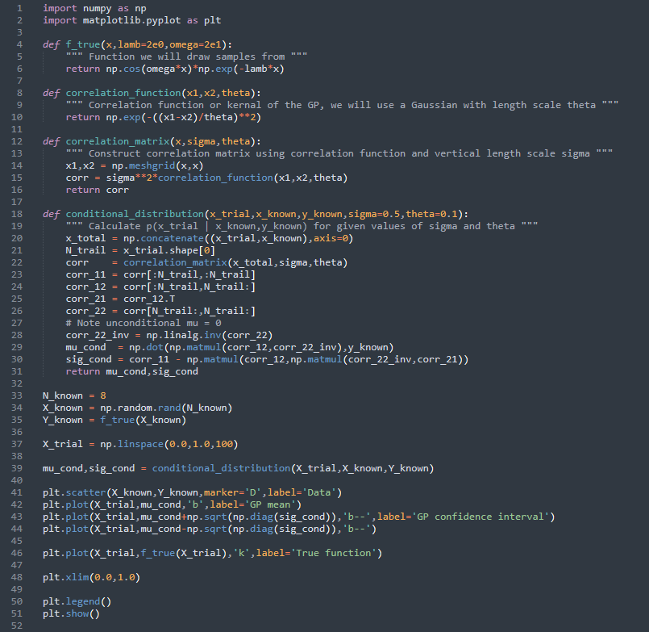
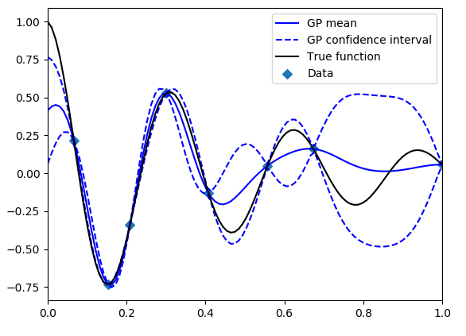
Gaussian Processes: Example

Slide 26
Neural Networks

Slide 27
Neural Networks

Slide 28
Neural Networks: Example

Slide 29
Examples in the field

